Slide 1



ACADEMATES: PATH TO YOUR PERSONALIZED LEARNING
MAJOR PROJECT
BACHELOR OF TECHNOLOGY
IN
COMPUTER SCIENCE & ENGINEERING
(SOFTWARE ENGINEERING)
Faculty of Engineering & Technology
Jain (Deemed-To-Be University)
Department of Computer Science & Technology
Submitted by :
SACHIN SINGH
20BTRCS170
MANISH YADAV
20BTRSE037
AAYUSHMA THAPA
20BTRSE072
SAMYAK MAHARJAN
20BTRSE076
Under the guidance of
Mr. Karthikeyan S

Slide 2
index
Abstract
Problem Statement
Introduction
Objective
Methodology
Literature survey
Existing work
Limitation
Proposed System
Use-Case Diagram
Activity Diagram
Sequence Diagram
Implementation

Slide 3
Abstract
Academates is an innovative online education platform designed to bridge the gap between teachers and students. With a user-friendly interface built on React, teachers can register, create detailed profiles, and specify their expertise in subjects and topics. Students, in turn, can search for teachers based on their learning needs, viewing a curated list complete with teacher ratings. The platform facilitates seamless appointment scheduling with integrated video meetings featuring a whiteboard and screen sharing options. Payment transactions are securely processed through the platform, with a percentage allocated as the platform's service fee. With a robust rating and review system, Academates aims to foster a thriving educational community, offering a dynamic, secure, and personalized learning experience for both teachers and students.

Slide 4


Problem statement
In the rapidly evolving landscape of education, there exists a significant gap between qualified teachers and eager learners seeking personalized instruction. Traditional avenues of finding and engaging with educators are often cumbersome and lack transparency in terms of teacher proficiency and availability. Additionally, the absence of a seamless virtual learning environment with integrated collaboration tools inhibits effective remote instruction. To address these challenges, Academates endeavors to create a user-centric online platform that connects teachers and students, streamlining the process of discovering, scheduling, and conducting virtual lessons while ensuring transparency, security, and quality education. This platform will serve as a transformative intermediary in the education sector, revolutionizing the way knowledge is accessed and shared in the digital age.

Slide 5

Introduction
In an era defined by digital connectivity, education too must adapt to a more accessible, personalized, and interactive format.
Introducing Academates, a forward-thinking online education platform that acts as the conduit between dedicated teachers and eager learners. This revolutionizes the way knowledge is shared, providing a seamless interface for educators to showcase their expertise and for students to find the perfect mentor for their learning journey.
By integrating cutting-edge video conferencing technology with collaborative tools like a virtual whiteboard and screen sharing, Academates transforms the virtual classroom into an engaging, interactive space.
Moreover, our secure payment gateway ensures transparent and reliable financial transactions, benefiting both teachers and students alike.
With a vision to reinvigorate the educational landscape, Academates is poised to democratize access to quality education in an ever-evolving digital world.

Slide 6


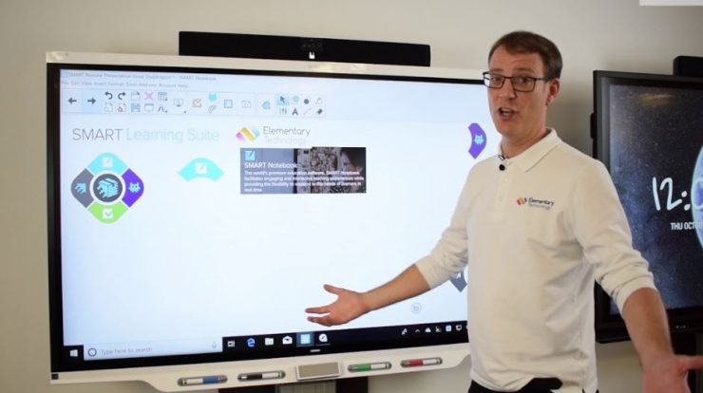
Objectives
Facilitate Seamless Connection: Develop a user-friendly interface that enables teachers to easily register, create comprehensive profiles, and specify their areas of expertise, while allowing students to effortlessly search and connect with suitable educators based on subjects and topics of interest.
Promote Educator Empowerment: Provide teachers with a platform to showcase their expertise, thereby expanding their reach and enabling them to share their knowledge with a broader audience, ultimately enhancing their professional development.
Optimize Learning Experience: Integrate video conferencing capabilities with an inbuilt whiteboard and screen sharing options to create an interactive and engaging virtual classroom experience, empowering teachers to effectively convey complex concepts.

Slide 7
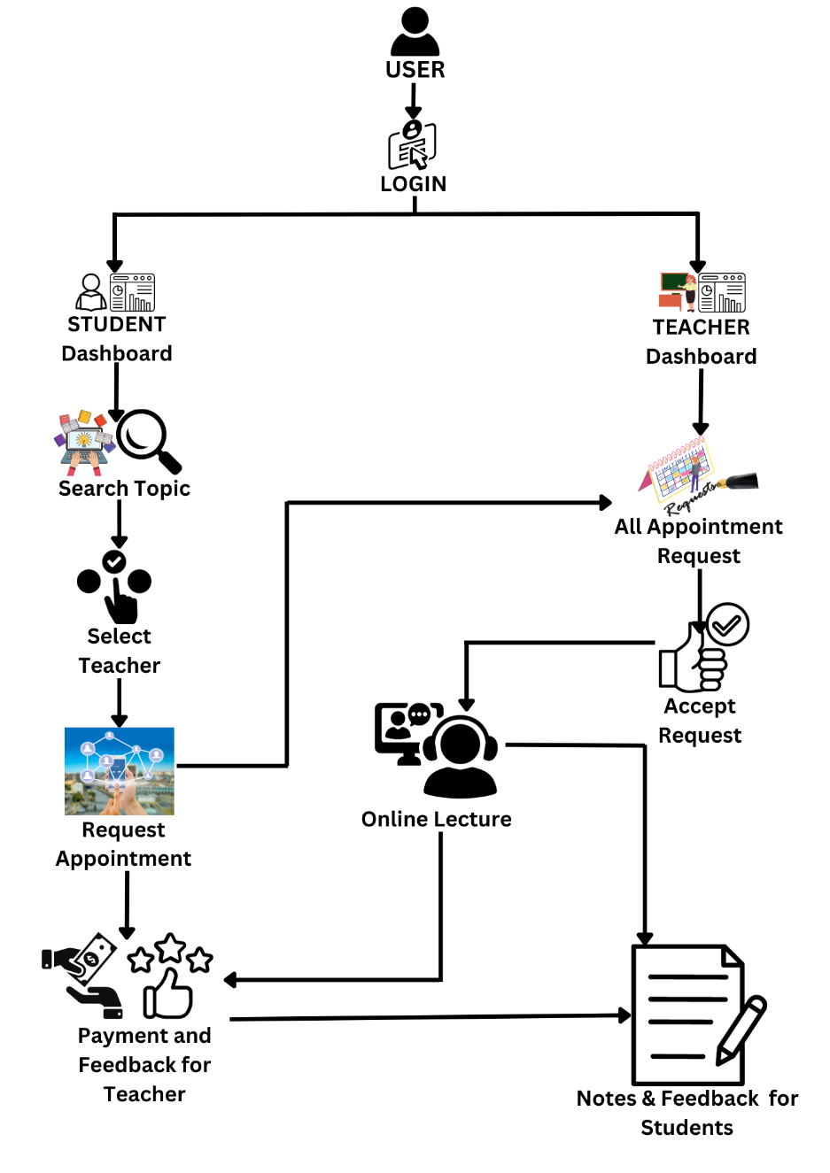
Proposed System
Teacher Side
Step 1: Teacher login
Step 2: Teacher opens his profile.
step 3: Teacher checks the lecture requests.
step 4: If lecture request is there, teacher accept or decline the request.
step 5: After accepting, teacher can come back on the accepted time and take class.
step 6: Add feedback about the students.
step 7: Get the payment.

Slide 8

Student side
Step 1: Student login
Step 2: Search for the desired lecture from the available teachers
Step 3: Submit a lecture request to the teacher.
Step 4: Wait for the teacher to accept or decline the request.
Step 5: If the request is accepted, be present at the scheduled time for the class.
Step 6: Participate actively in the class and take notes.
Step 7: After the class, review the feedback provided by the teacher, if any and provide feedback to the teacher for overall studying experience.
Step 8: Make the payment for the attended class.
Step 9: Check own profile for the progress

Slide 9


Methodology
Technology Used
Front-End Development:
React: For building the user interface and ensuring a dynamic, interactive user experience.
HTML/CSS/JavaScript: Fundamental web technologies for structuring content, styling, and adding interactivity.
Back-End Development:
Node.js with Express.js (or alternative backend framework): For handling server-side operations, managing routes, and handling database interactions.
Database (e.g., PostgreSQL, MongoDB): To store user information, teacher profiles, subjects, appointments, reviews, and more.
Database Management:
PostgreSQL/MySQL (or MongoDB): For structured data management, querying, and retrieval.
Video Conferencing Integration:
WebRTC: For enabling real-time video meetings between teachers and students.
Socket.io: To facilitate real-time communication during video sessions.
Cont…..

Slide 10



Methodology
Payment Gateway Integration:
Stripe, PayPal, or similar: To handle secure payment transactions between students and teachers.
Authentication and Authorization:
JSON Web Tokens (JWT): For secure authentication and authorization of users.
Version Control:
Git/GitHub: For collaborative development and version control.
Deployment:
Cloud Platform (e.g., AWS, Google Cloud, or Heroku): To host and deploy the application.

Slide 11

Methodology
Development Requirement
User Authentication System:
Implement a robust authentication system to securely manage user accounts and sessions.
Teacher and Student Profiles:
Create user interfaces for teachers to register, add profile information, and specify their teaching subjects and topics.
Develop student profiles for searching and connecting with teachers.
Search and Matching Algorithm:
Design an algorithm to match students with suitable teachers based on subjects, topics, and availability.
Appointment Scheduling System:
Develop a calendar-based scheduling system for teachers to set availability and for students to book appointments.
Video Conferencing and Collaboration Tools:
Integrate WebRTC for video meetings with features like whiteboard and screen sharing for interactive learning sessions.
Payment System:
Integrate a payment gateway to handle transactions between students and teachers, including platform fees.

Slide 12



Methodology
Hardware and Software Requirements:
Server and Hosting:
A robust server capable of handling concurrent video sessions.
Cloud hosting services like AWS, Google Cloud, or Heroku for deployment.
Database Server:
Suitable hardware for hosting and managing the database.
Development Environments:
Computers/laptops with sufficient processing power and memory for development work.
Development Tools:
Code editors (e.g., Visual Studio Code, Sublime Text) for writing and editing code.
Git for version control.
Node.js and npm (Node Package Manager) for managing dependencies.
Video Conferencing Equipment:
High-quality cameras and microphones for teachers and students participating in video sessions.
Browser Compatibility:
Ensure the platform is compatible with popular web browsers like Chrome, Firefox, Safari, and Edge.

Slide 13
Literature survey
S.N. | Paper Name | Main Idea of the Paper | Solution Provided by Academates
1 | Smart Education Platform to Enhance Student Learning Experience during COVID-19 | Implementing Smart Education to enhance learning during COVID-19, emphasizing Smart Cities and tools like Zoom. | Academates offers a virtual learning environment with similar tools to enable continued education during disruptions.
2 | Technological Spotlights of Digital Transformation in Tertiary Education | The role of digital transformation in globalized tertiary education, highlighting AI, IoT, and blockchain. | Academates could incorporate these technologies to enhance its educational services and platform efficiency.
3 | A Comparative Study of Implementing Innovation in Education Sector Due to COVID–19 | Comparative study on innovation in education due to COVID-19, with a focus on adaptability to technologies. | Academates adapts to new technologies, offering online teaching and video meetings to facilitate education.
4 | E-Learning Platform of STEAM Aesthetic Course Materials Based on User Experience | Integrating Kolb's experiential learning cycle into e-learning platforms for enhanced user intention and performance. | Academates could use similar educational theories to design its platform for improved learning outcomes.

Slide 14
Literature survey
S.N. | Paper Name | Main Idea of the Paper | Solution Provided by Academates
5 | Unified and Flexible Online Experimental Framework for Control Engineering Education | A unified experimental framework for control education using a front-end and back-end separation scheme. | Academates can adopt a similar architectural approach to create a seamless user experience in online control education.
6 | Usability Evaluation of Learning Management System | The importance of LMS in education, focusing on UI/UX evaluation methods like usability measurement. | Academates prioritizes UI/UX in its LMS, ensuring an effective and user-friendly platform for its users.
7 | Attaining 21st Century Skills In A Virtual Classroom | Using virtual classrooms to develop 21st-century skills, with a focus on digital resources' enhancement. | Academates provides a virtual classroom environment that fosters the development of these essential skills.
8 | The importance of interaction mechanisms in blended learning courses involving problem solving e-tivities | Identifying interaction mechanisms in blended learning to enhance problem-solving e-tivities. | Academates can implement similar interaction mechanisms to improve collaborative problem-solving in its courses.

Slide 15
Literature survey
S.N. | Paper Name | Main Idea of the Paper | Solution Provided by Academates
9 | MetaClassroom: A WebXR-based Hybrid Virtual Reality Classroom | Designing a virtual reality classroom using WebXR technology to offer an immersive learning experience. | Academates might explore VR to provide an immersive experience in its virtual classrooms.
10 | Payatron – Secure electronic transaction processing system | The significance of secure online payment systems in e-commerce, presenting Payatron as a solution. | Academates could use secure payment solutions like Payatron to handle transactions within its platform.
11 | Web based Payment Tracking and Accounting Application | Introducing the Payment Tracking System (PTS) for efficient management of vendor payments. | Academates could incorporate a tracking system to manage and streamline its financial transactions.
12 | Unified Payment Interface—An Advancement in Payment Systems | Exploration of UPI as a real-time interbank payment system, emphasizing its architecture and security. | Academates could adopt UPI principles to enhance its payment infrastructure for user convenience.

Slide 16
Literature survey
S.N. | Paper Name | Main Idea of the Paper | Solution Provided by Academates
13 | Data security and protection: a mechanism For managing data theft and cybercrime in Online platforms of educational Institutions | Addressing cybercrime and data theft in educational institutions with robust security mechanisms. | Academates ensures data security and protection to prevent unauthorized access and safeguard user data.
14 | Data Privacy Protection from the Perspective of GDPR - A Case Study on E-learning Platform "SHCneo" | Safeguarding data privacy in e-learning platforms in accordance with GDPR, using SHCneo as a case study. | Academates can implement GDPR-compliant data privacy measures to protect users' personal information.
15 | Securing E-learning Platforms | The importance of securing e-learning platforms and the use of information security tools. | Academates utilizes security tools and protocols to protect its e-learning platform and user data.

Slide 17
Literature survey
S.N. | Paper Name | Main Idea of the Paper | Solution Provided by Academates
16 | Profiling Users’ Behavior, and Identifying Important Features of Review ‘‘Helpfulness’’ | Impact of user rating behavior on review helpfulness and the interest of businesses and reviewers. | Academates could consider user rating behaviors to enhance the relevance and usefulness of teacher reviews.
17 | Student Satisfaction and Churn Predicting using Machine Learning Algorithms for EdTech course | Using machine learning algorithms to predict student satisfaction and churn in EdTech courses. | Academates could employ predictive analytics to identify and address student dissatisfaction proactively.
18 | Perception and Practices of EdTech Platform: A Sentiment Analysis | Sentiment analysis on user perceptions of EdTech platforms during the pandemic. | Academates can analyze user feedback to improve its services and adapt to the educational landscape.

Slide 18
Existing work
There are several online platforms that provide services similar to what Academates offers. Some well-known examples include:
Udemy
Coursera
edX
Skillshare
Chegg Tutors
Wyzant

Slide 19
Limitation of existing works
Lack of Personalization
Quality Control
Limited Interactivity
Instructor Credibility
Limited Hands-On Learning
High Competition

Slide 20
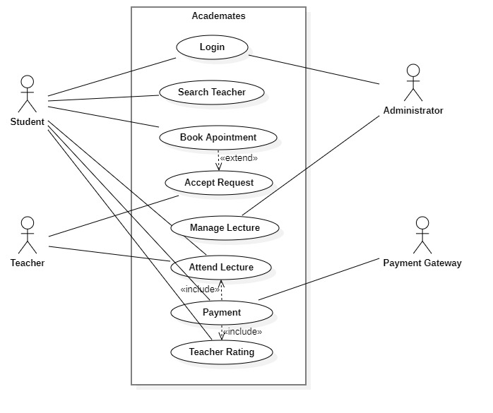
Use-case diagram

Slide 21
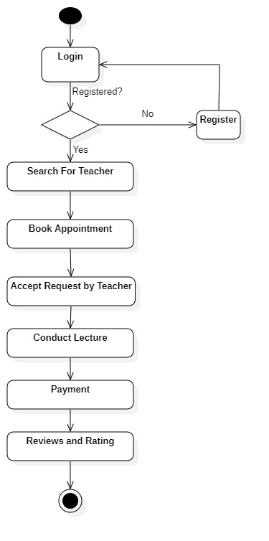
Activity diagram

Slide 22
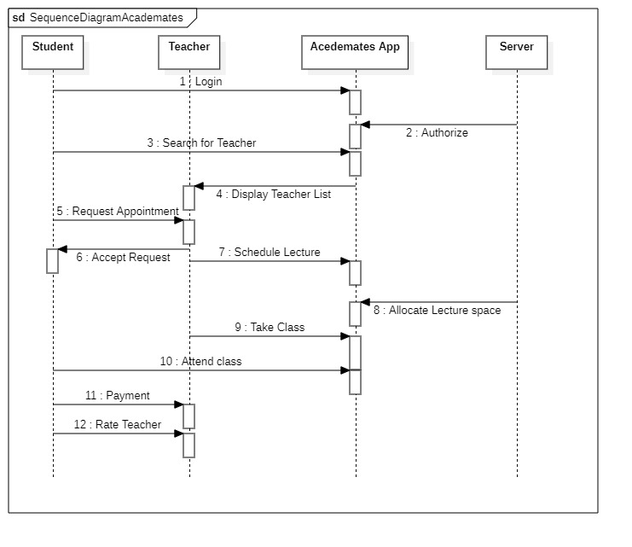
Sequence diagram

Slide 23
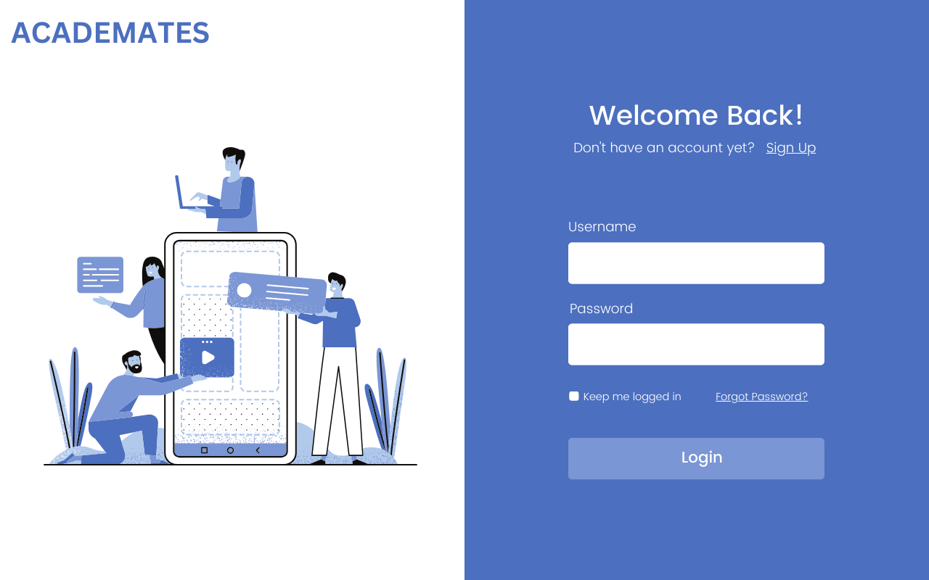
Implementation

Slide 24
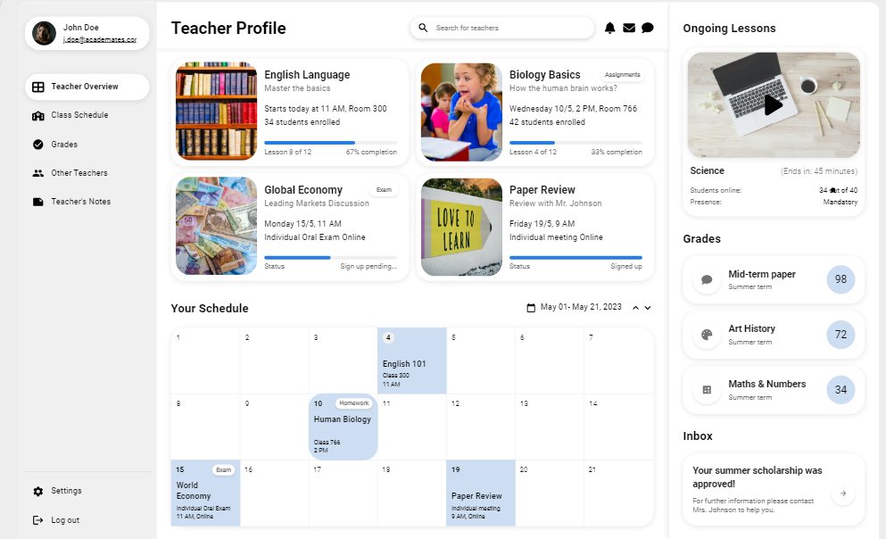

Slide 25
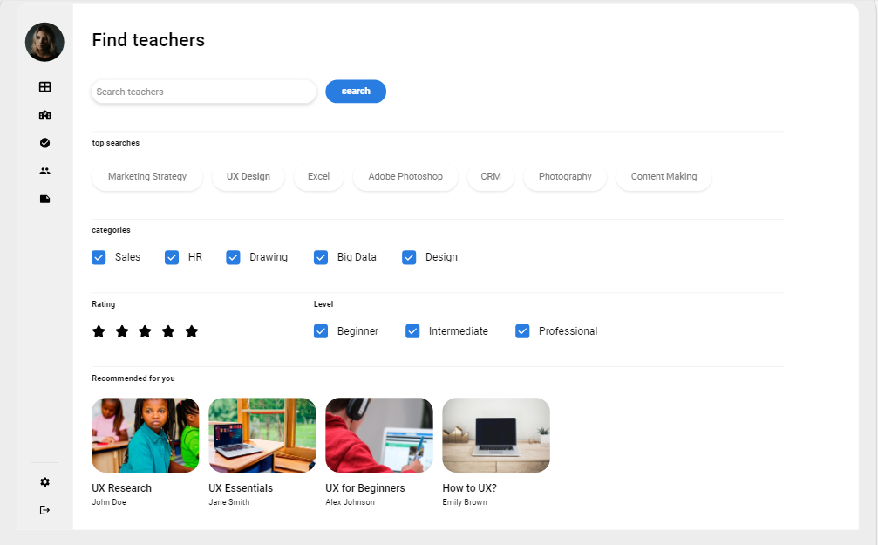

Slide 26
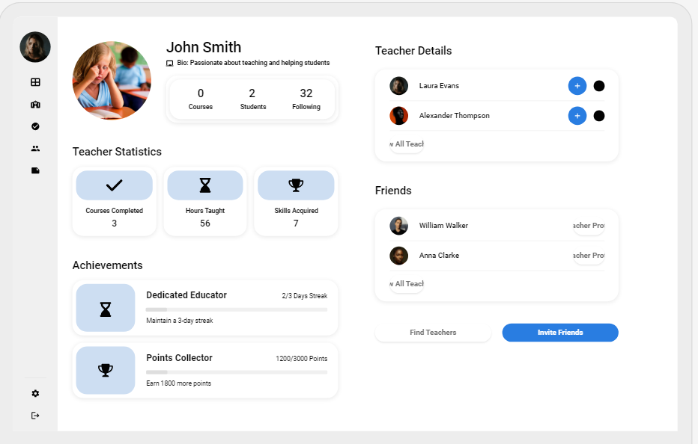

Slide 27
THANK YOU
Submitted by :
SACHIN SINGH
20BTRCS170
MANISH YADAV
20BTRSE037
AAYUSHMA THAPA
20BTRSE072
SAMYAK MAHARJAN
20BTRSE076
Under the guidance of
Mr. Karthikeyan S

